Slide 1

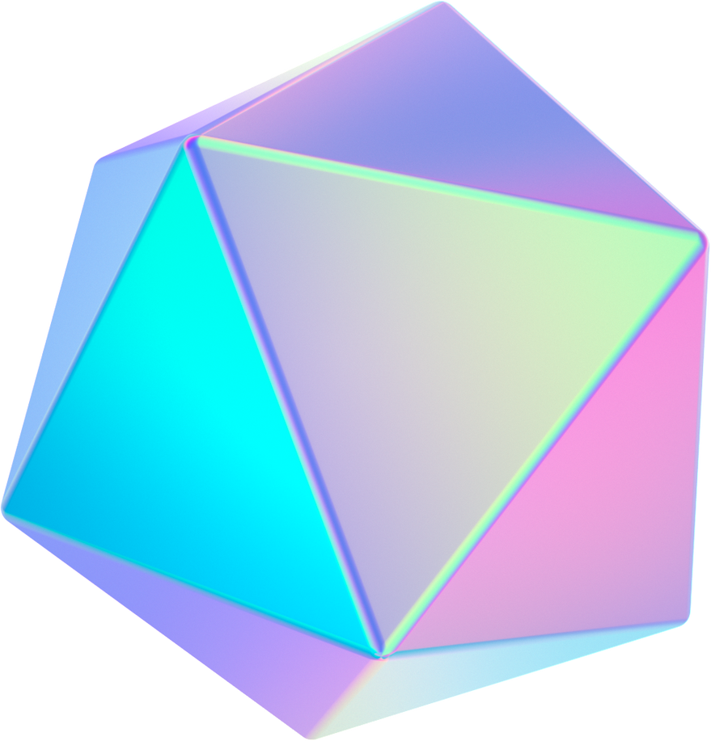




Futuristic Ad generator

Slide 2

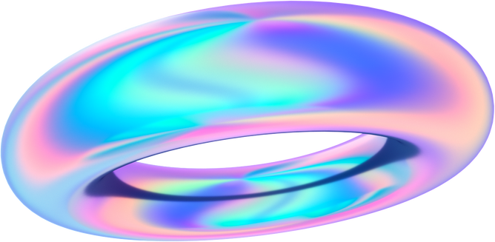

Introduction
Problem Statement:
Ads not reaching the target audience.
Repetition of ads.
Low attention spans of users.
Time-consuming ad creation methods.
Feedback process extremely slow.
Lack of interesting ad generation techniques.

Slide 3
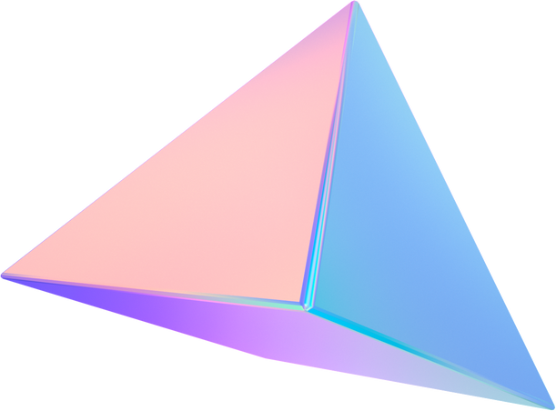
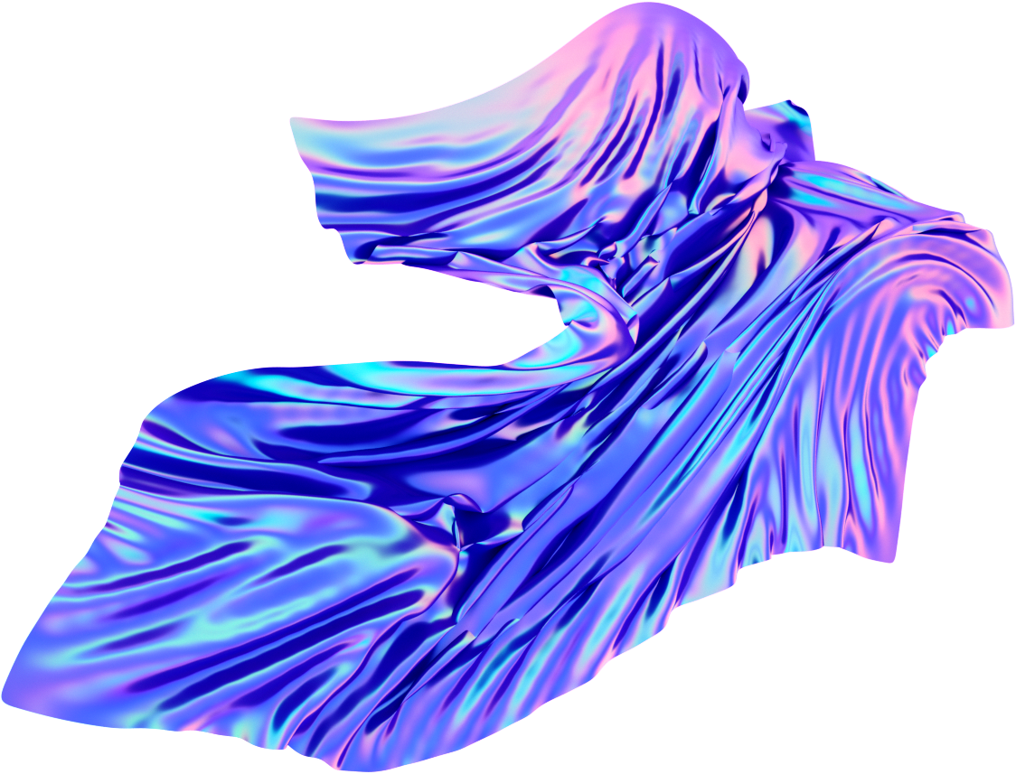
Goals
An agentic-AI system that integrates company research, prompt engineering and ideation and tagline and image generation with feedback for improvement.
Concise process saving time in creation
Revolutionizing ad generation to cater to targeted audience.​
Automation of the entire advertisement creation pipeline taking feedback at every step.

Slide 4

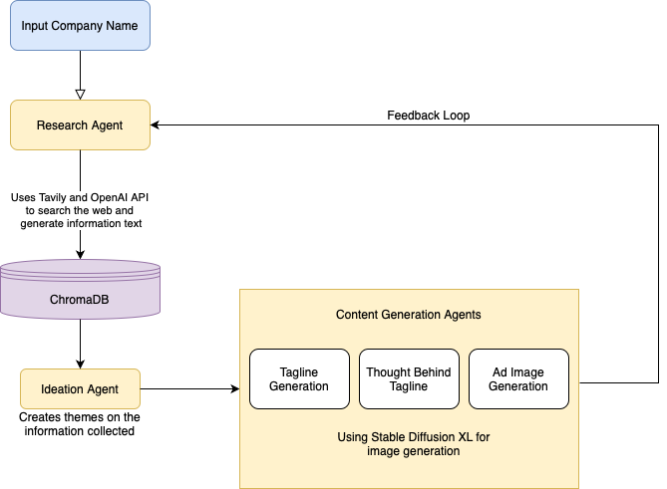
Flowchart

Slide 5
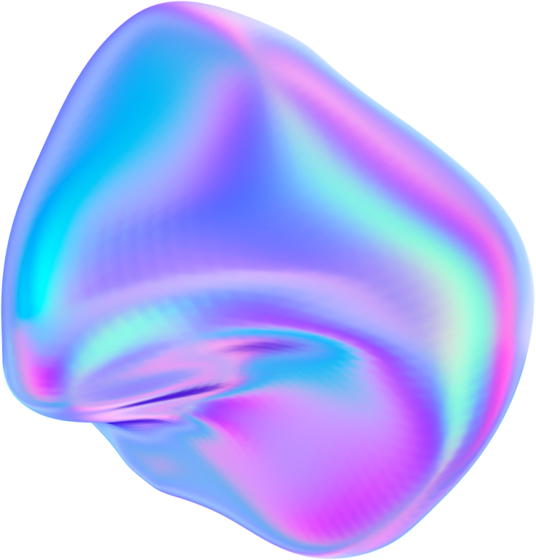


Demo
Ideation
Brand Research
Ad generation

Slide 6
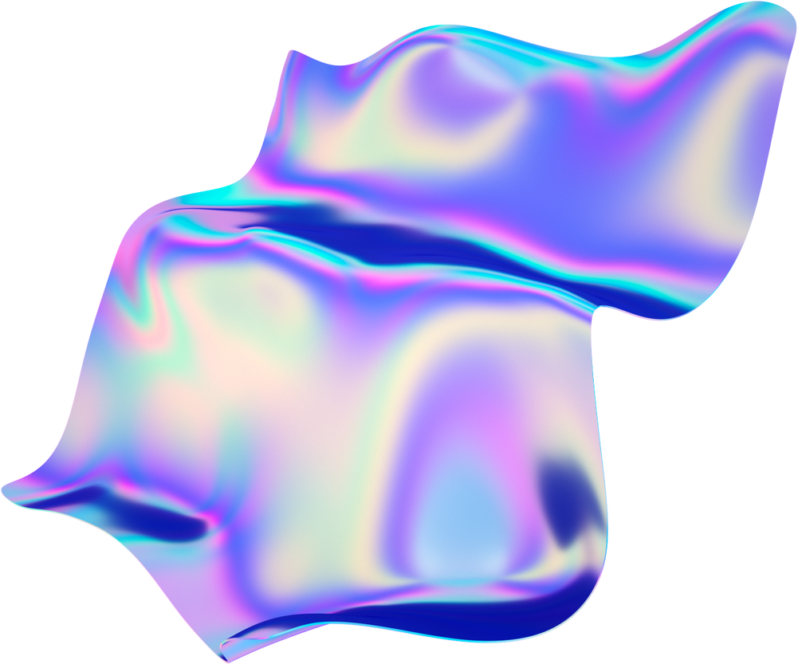

Future Scope
Q1
Q2
Q3
Adding realtime AB testing
Improving the image generation models
Fine tuning the research assistant

Slide 7

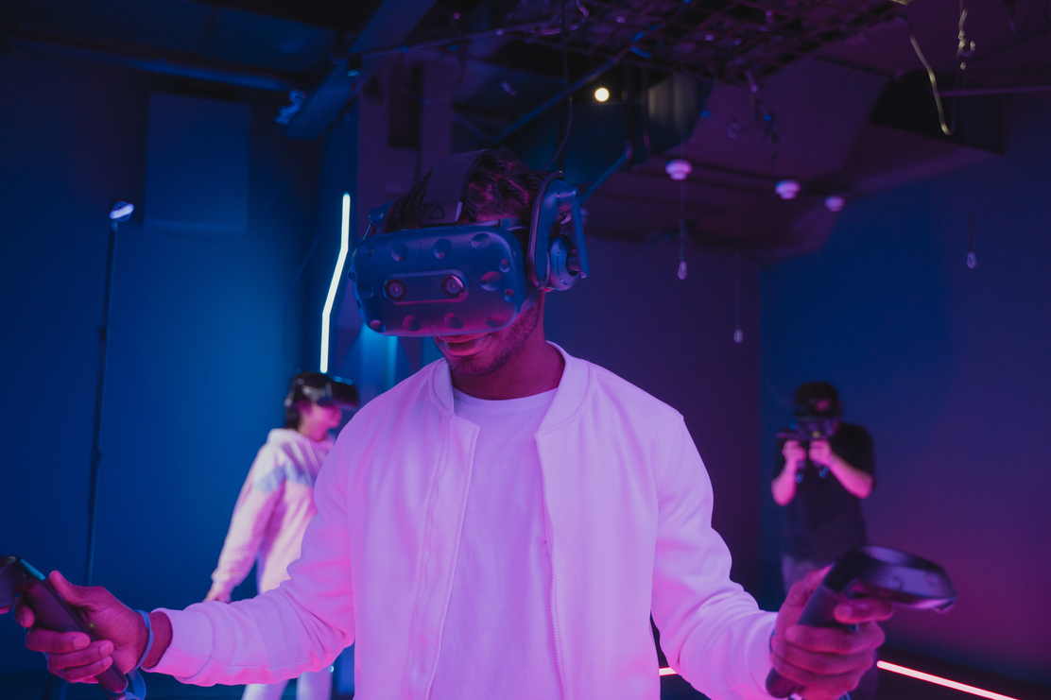
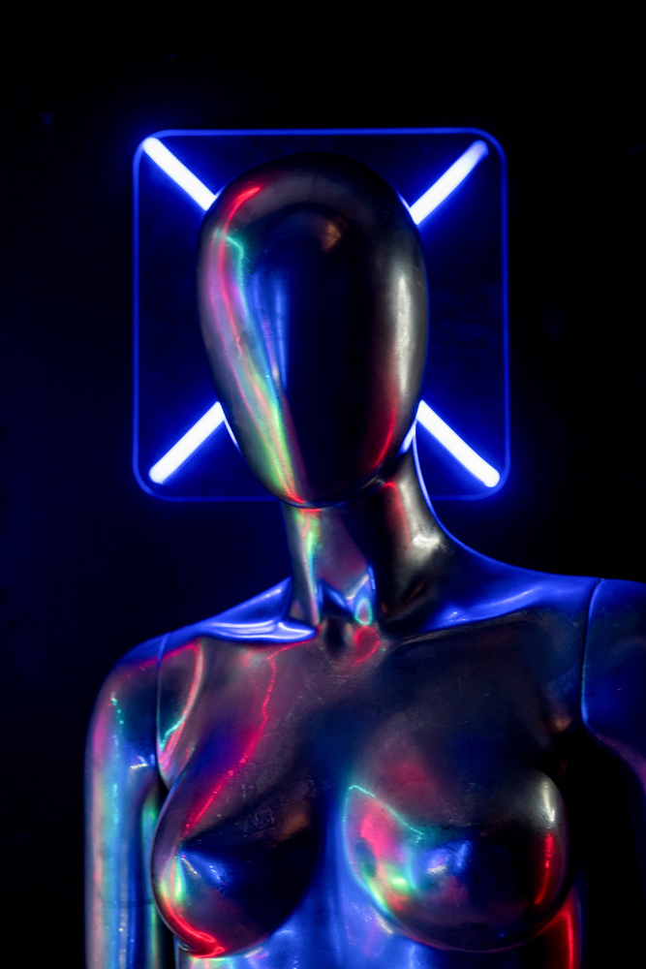
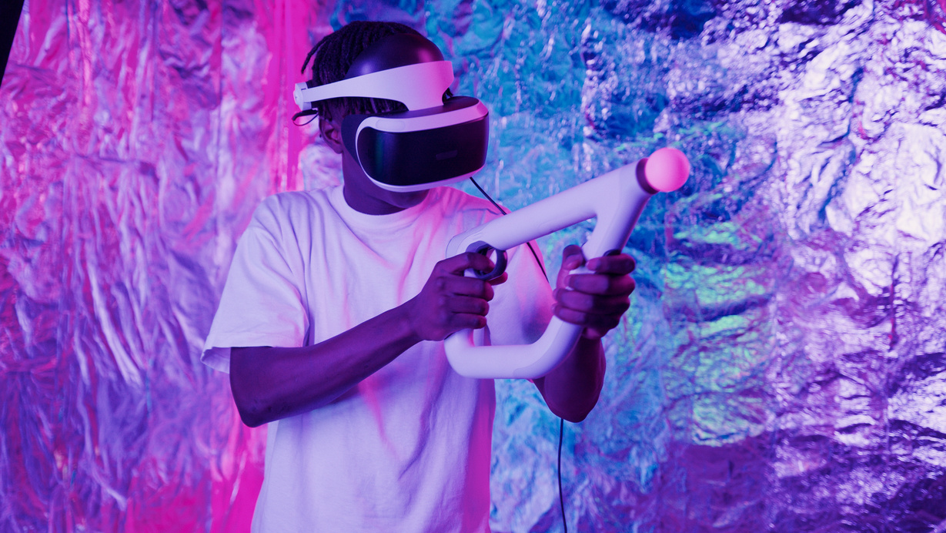
Team
NARASIMHA KARTHIK JWALAPURAM
VAISHNAVI S
VRISHANI SHAH
PHANI KIRAN

Slide 8

Thank You

